Slide 1
Likelihood Ratio Tests
Himanshi Pahuja (102018009)
Divija (102018056)
Aniket Sahran (102018065)

Slide 2
What Will We Study?
Likelihood function
Building Hypothesis
What is Likelihood Ratio Test?
How to choose constant c?
Examples
Applications
Advantages
Limitations
Alternatives

Slide 3
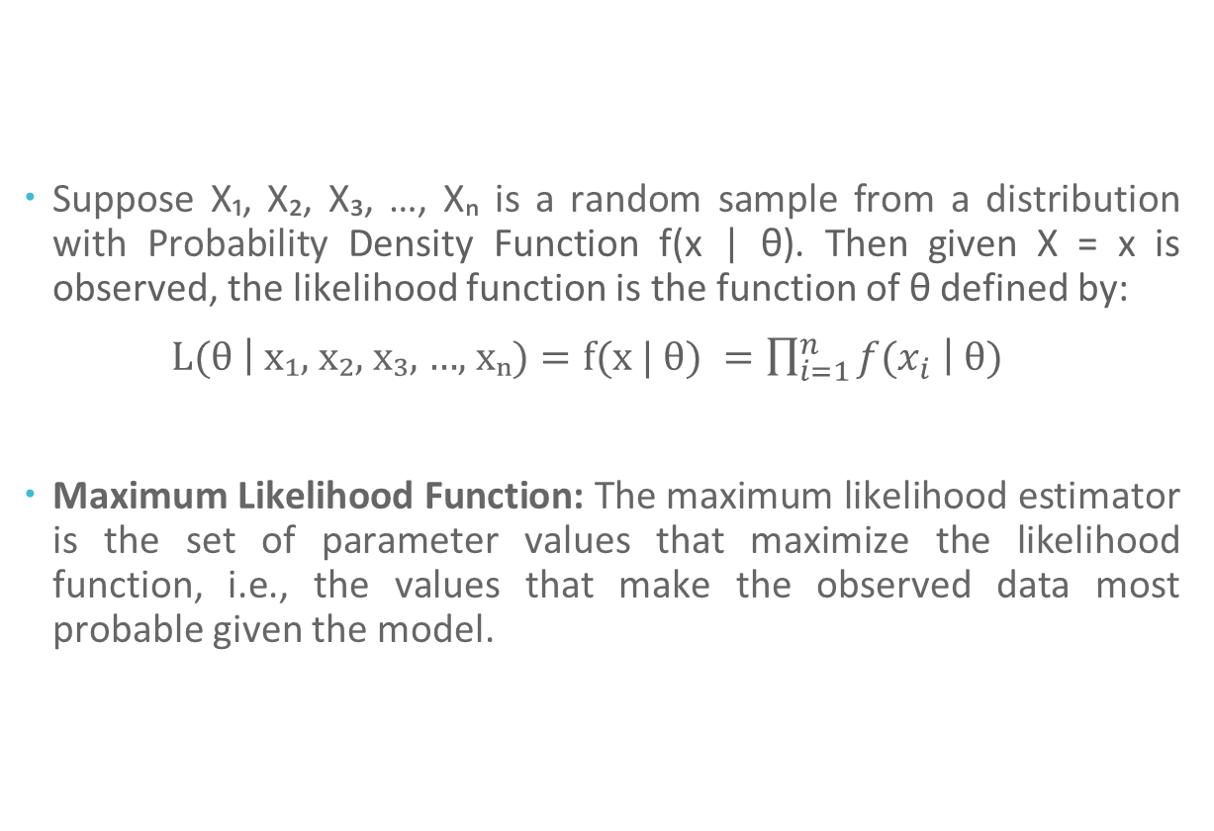
Likelihood Function
Suppose X₁, X₂, X₃, …, Xₙ is a random sample from a distribution with Probability Density Function f(x | θ). Then given X = x is observed, the likelihood function is the function of θ defined by:
L(θ $\left| \text{x}\text{₁}\text{, }\text{x}\text{₂}\text{, }\text{x}\text{₃}\text{, }\text{…}\text{, }\text{x}\text{ₙ}\text{)}=\text{f}\text{(}\text{x}\text{ | }\text{θ}\text{) }=\prod_{i=1}^{n}{f(x_{i} }\right| θ)$
Maximum Likelihood Function: The maximum likelihood estimator is the set of parameter values that maximize the likelihood function, i.e., the values that make the observed data most probable given the model.

Slide 4
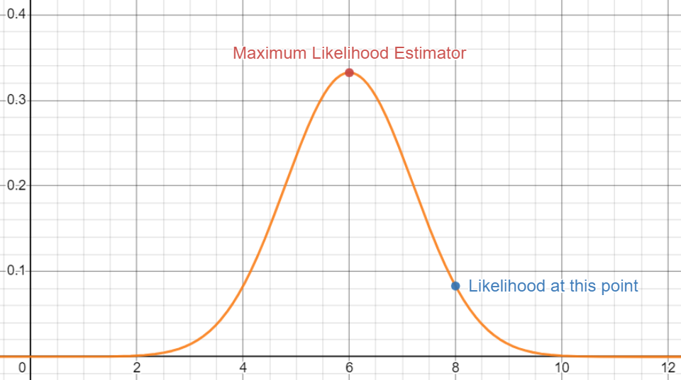
What does it look like?
For example, consider a normal distribution with the mean 6 and standard deviation 1.2, with the following graph.

Slide 5
Likelihood Ratio Tests
The Likelihood-Ratio Test (LRT) is a statistical test used to compare the goodness of fit of two competing statistical models based on the ratio of their likelihoods.
It assesses if the constraint (i.e. the null hypothesis) is supported by the observed data and can be used to find out which model is the best fit.
Purpose: The likelihood ratio test aims to determine whether a new model is a better fit for the data than an old model.
Significance: The significance of the likelihood ratio test is that it provides a statistical test for the hypothesis that the new model is a better fit than the old model.

Slide 6
Wait a second. Hypothesis?
The null hypothesis typically states that there is no significant difference between the observed data and the expected data. This means that any differences observed between the data sets are likely due to chance, and there is no real effect being measured.
The alternative hypothesis, on the other hand, proposes that there is a significant difference between the observed and expected data, indicating the presence of a real effect being measured.

Slide 7
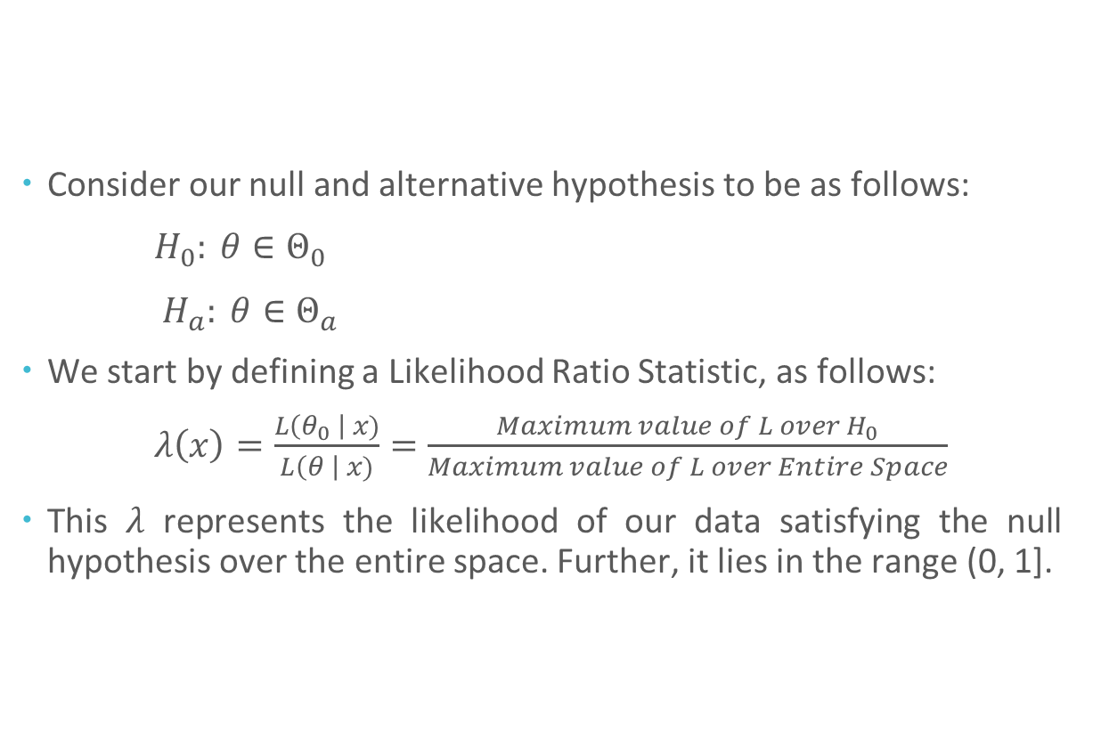
Let’s start with the Maths.
Consider our null and alternative hypothesis to be as follows:
$H_{0}: θ∈{\text{Θ}}_{0}$
$H_{a}: θ∈{\text{Θ}}_{a}$
We start by defining a Likelihood Ratio Statistic, as follows:
$λ\left(x\right)=\frac{L\left(θ_{0} \right| x)}{L\left(θ \right| x)}=\frac{Maximum value of L over H_{0}}{Maximum value of L over Entire Space}$
This $λ$ represents the likelihood of our data satisfying the null hypothesis over the entire space. Further, it lies in the range (0, 1].
̂
̂

Slide 8
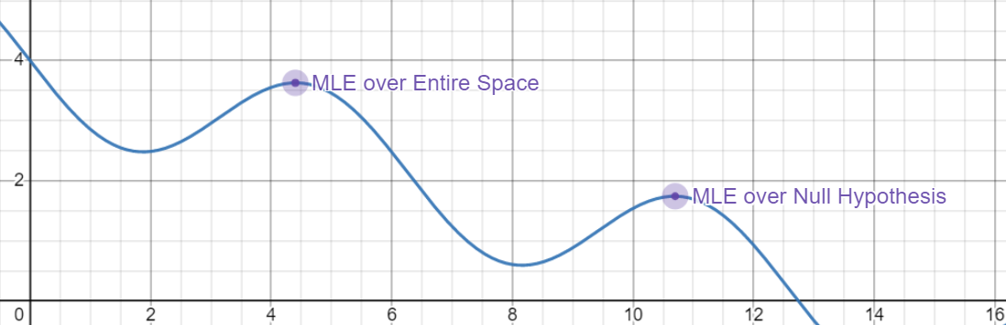
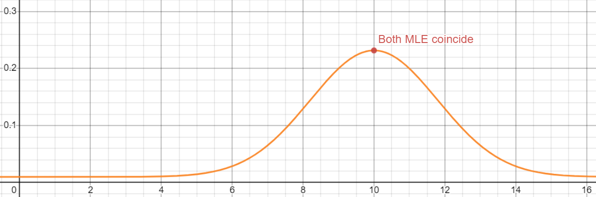
Likelihood Ratio Statistic

Slide 9
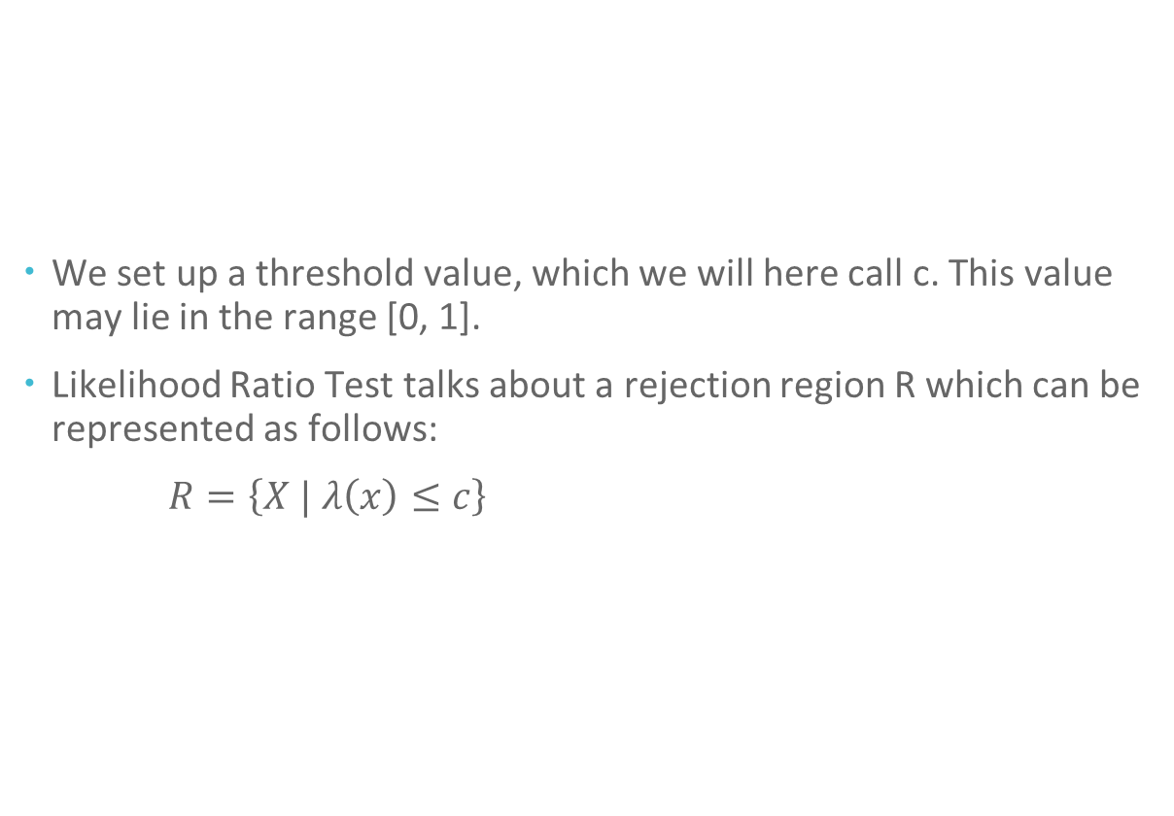
Using this statistic to test
We set up a threshold value, which we will here call c. This value may lie in the range [0, 1].
Likelihood Ratio Test talks about a rejection region R which can be represented as follows:
$R=\left\{X | λ\left(x\right)≤c\right\}$

Slide 10
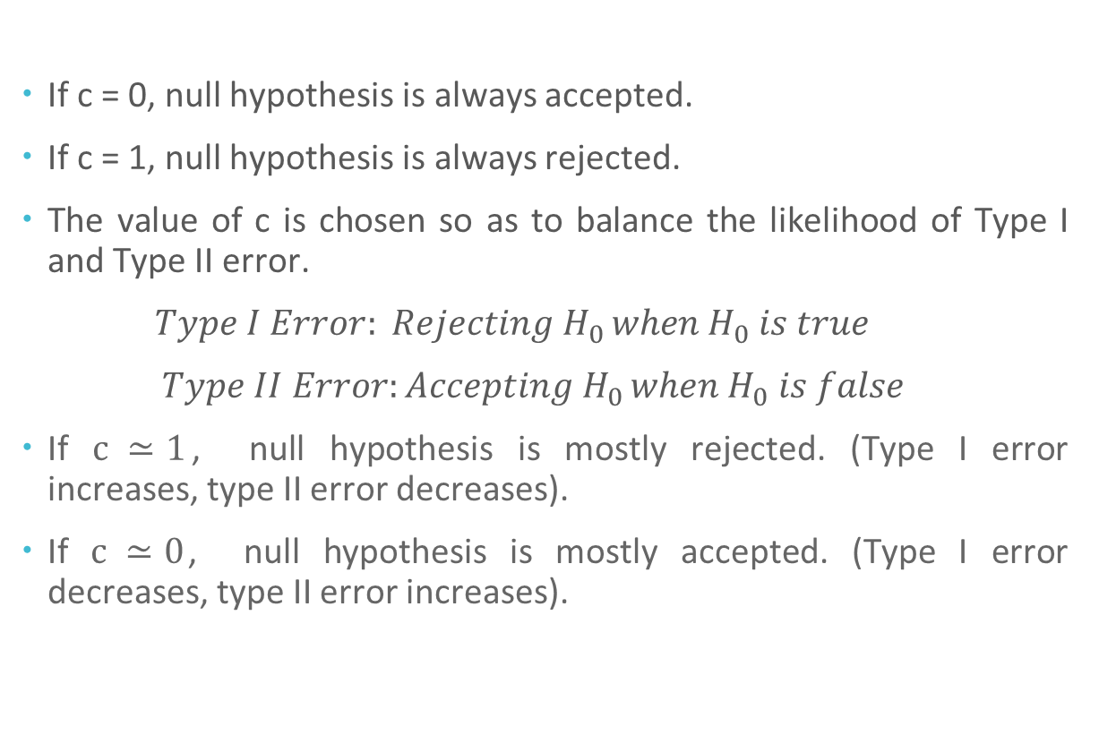
What will be the value of c?
If c = 0, null hypothesis is always accepted.
If c = 1, null hypothesis is always rejected.
The value of c is chosen so as to balance the likelihood of Type I and Type II error.
$Type I Error: Rejecting H_{0 }when H_{0} is true$
$Type II Error:Accepting H_{0 }when H_{0} is false$
If $c ≃1$, null hypothesis is mostly rejected. (Type I error increases, type II error decreases).
If $c ≃0$, null hypothesis is mostly accepted. (Type I error decreases, type II error increases).

Slide 11
Applications
Quality Control in Manufacturing
LRT is commonly used in manufacturing to ensure that the quality of a product meets the required standards.
LRT is used to compare the quality of two production processes and determine which one produces a higher percentage of defect-free products.

Slide 12
Applications
Credit Risk Management
LRT is used to compare two different credit risk models and select the one that provides a better fit for the data.
Helps to evaluate creditworthiness and determine the probability of default.
e.g. American Express, JP Morgan, and Chase.

Slide 13
Applications
Marketing
A/B testing is a popular technique used in marketing to compare two versions of an advertisement, website, or product and determine which one performs better.
LRT is used to evaluate the statistical significance of the results obtained from A/B testing.

Slide 14
Advantages
Flexibility
Statistical power
Provides a measure of fit
Controls for overfitting
Simplicity

Slide 15
Limitations
Assumption of nested model structure
Dependence on the null model
Sensitivity to sample size
Lack of robustness

Slide 16
Alternatives
Wald test
Compares the fit of two models
Compares the difference in their parameter estimates to the standard error of the estimates
Less powerful than the LRT
Simpler to implement
Less sensitive to sample size
Score test
Compares the difference in log-likelihoods to the derivative of the log-likelihood with respect to the parameter of interest
Less powerful than the LRT
Robust to model misspecification
Can be used in non-parametric models

Slide 17
References
https://jnu.ac.bd/journal/assets/pdf/7_1_211.pdf
https://www.probabilitycourse.com/chapter8/8_4_5_likelihood_ratio_tests.php
Introduction to Probability by Hossein Pishro-Nik
Probability and Statistical Inference by Robert V. Hogg, Elliot A. Tanis and Jagan Mohan Rao

Slide 18
Thank you!

